Slide 1
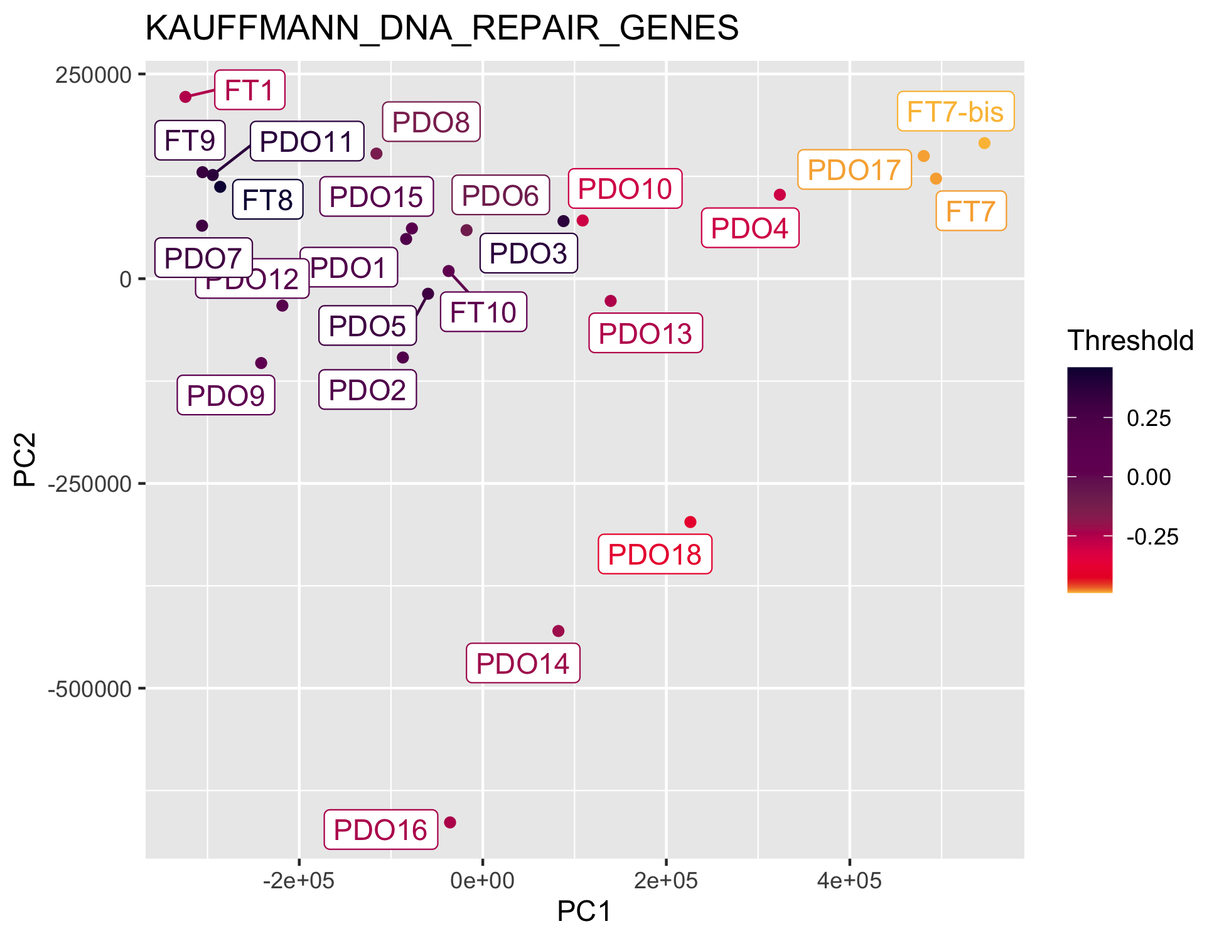
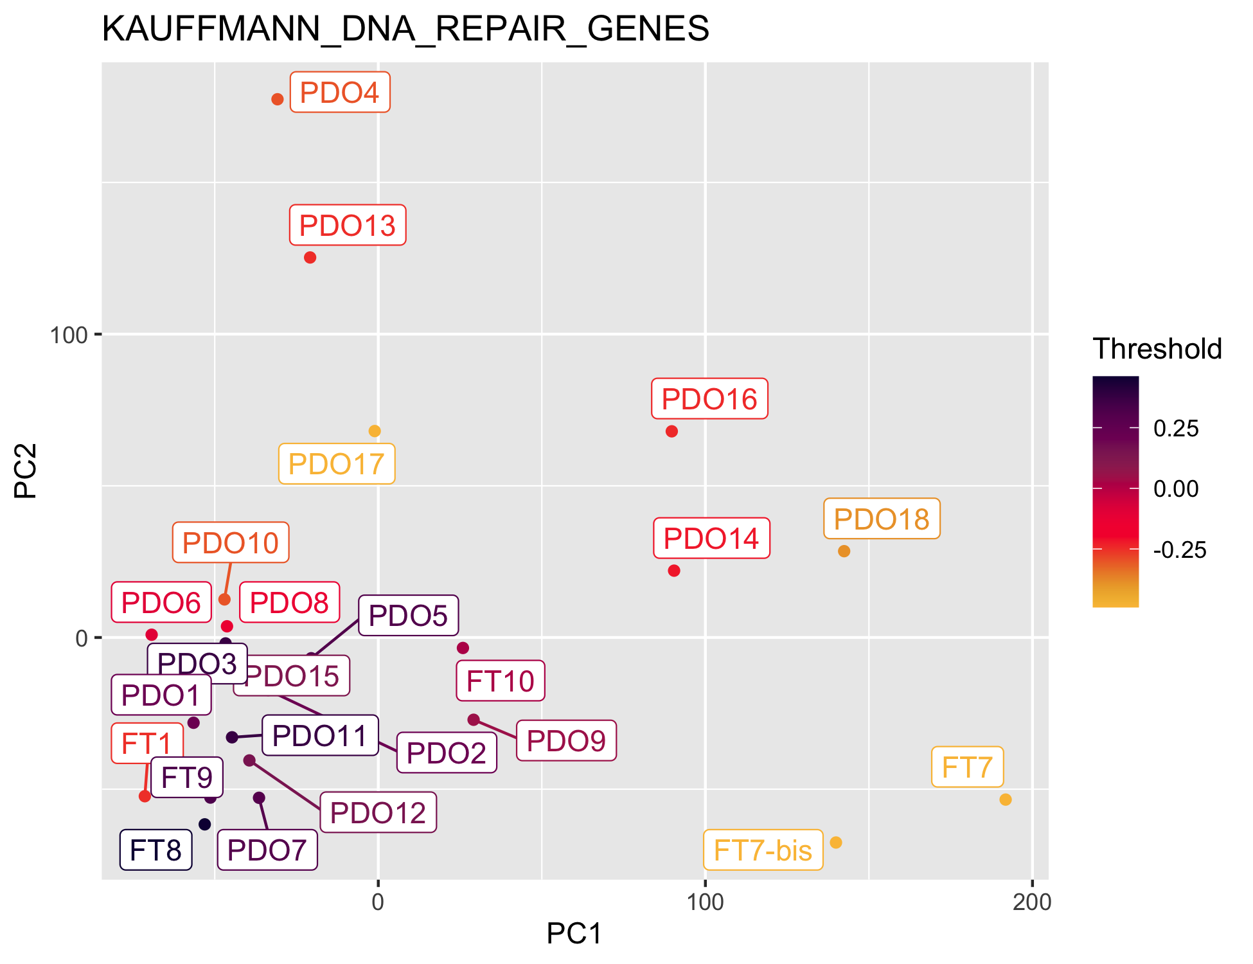
The first PC seems to reflect repair genes when doing an unscaled PCA with TPM, but not a scaled+centered PCA with the normalized genes
Including normal

Slide 2
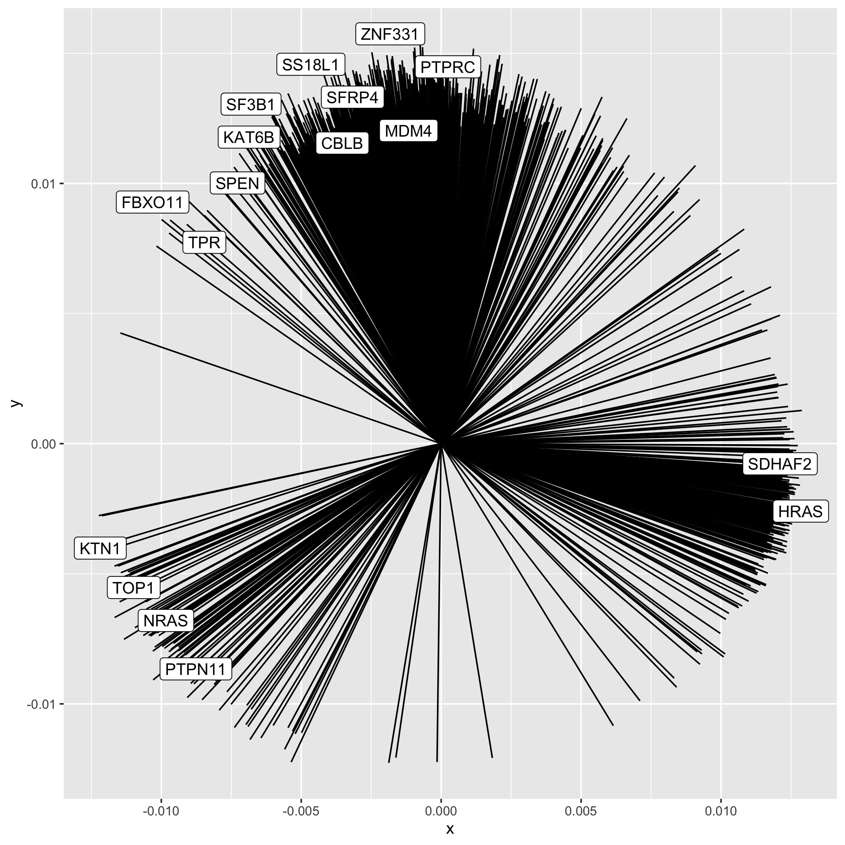
Tier 1 genes from Cancer Gene Census (CGC) which are also part of the top 500 most variable genes. PCA done on normalised counts of all genes
Including normal
Normalised counts

Slide 3
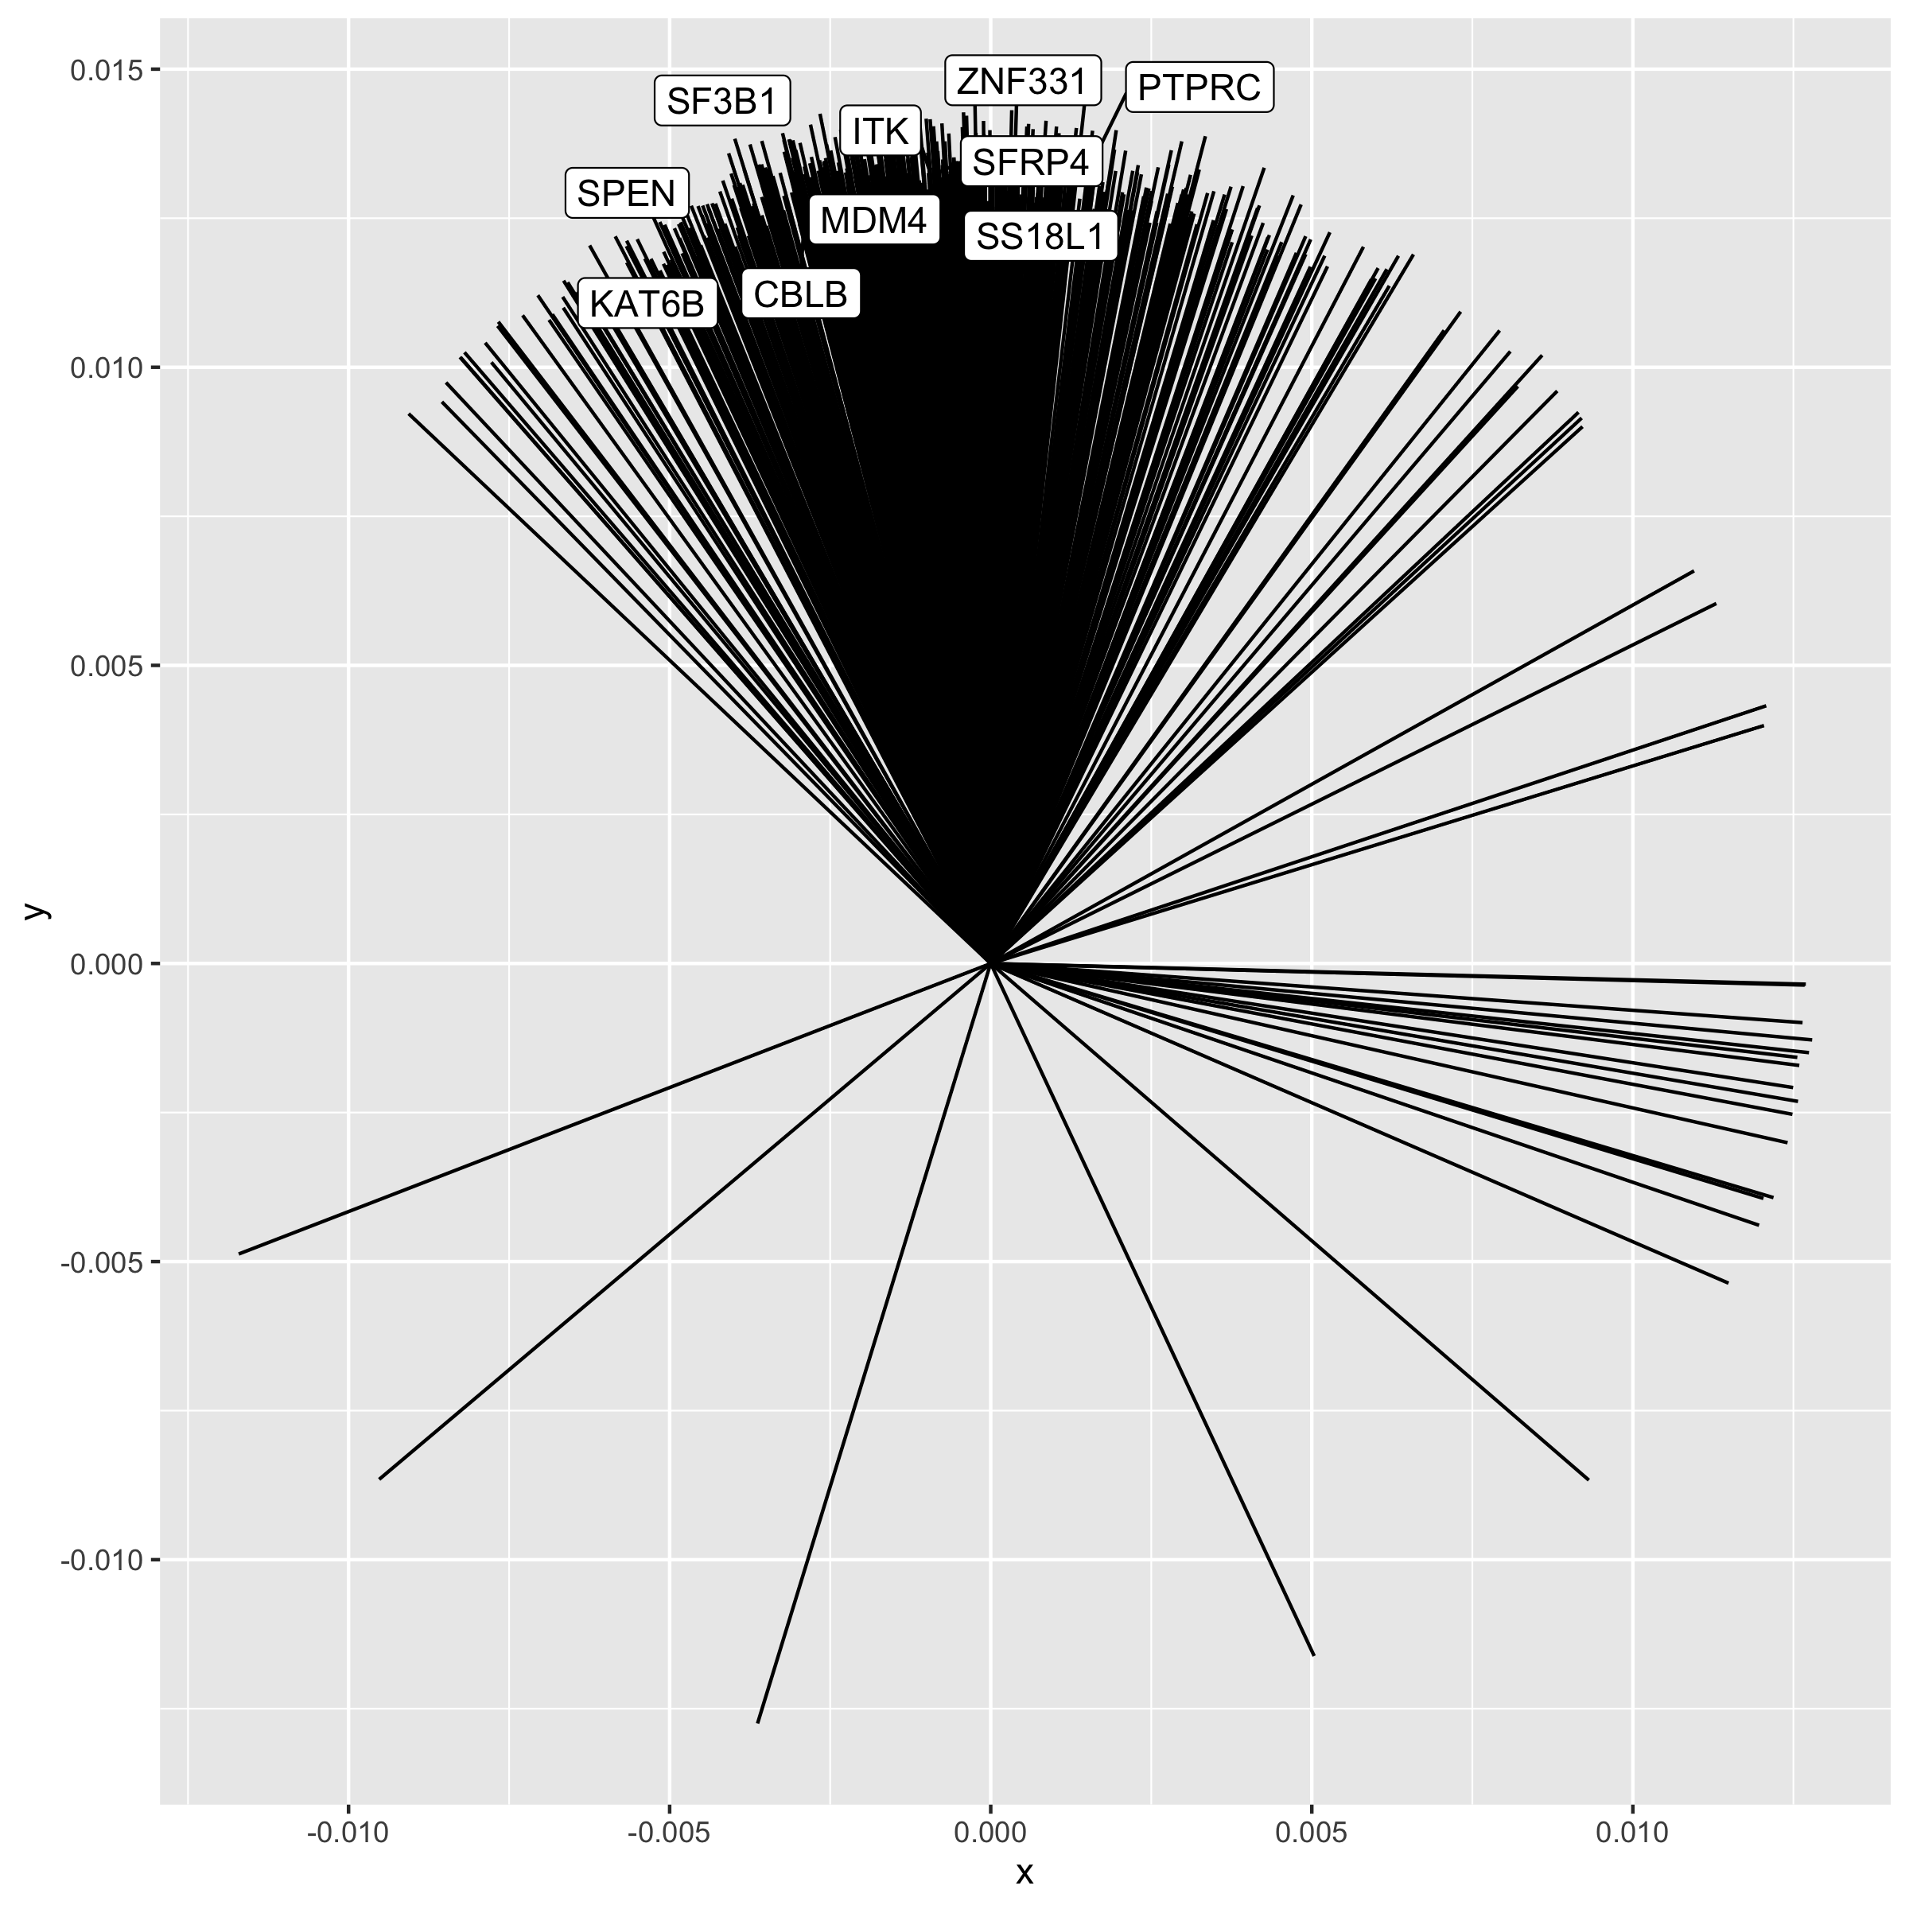
When only including organoids, the most variable genes are now the ones that determine PC2 only, but they are the same as those in the previous slide
Only including organoids
Normalised counts

Slide 4
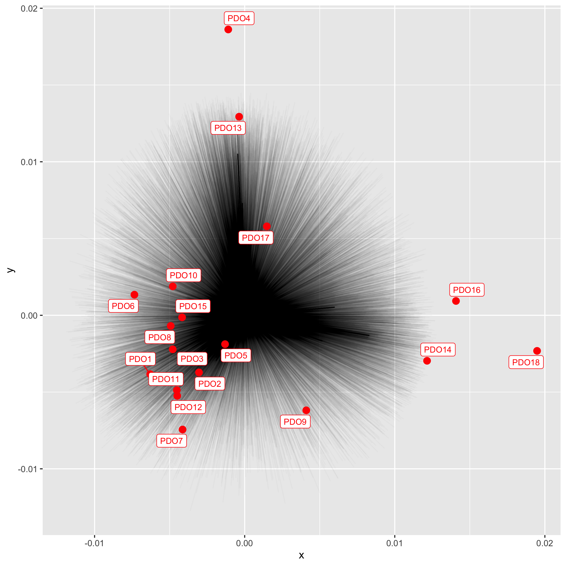
Only including organoids
Normalised counts

Slide 5
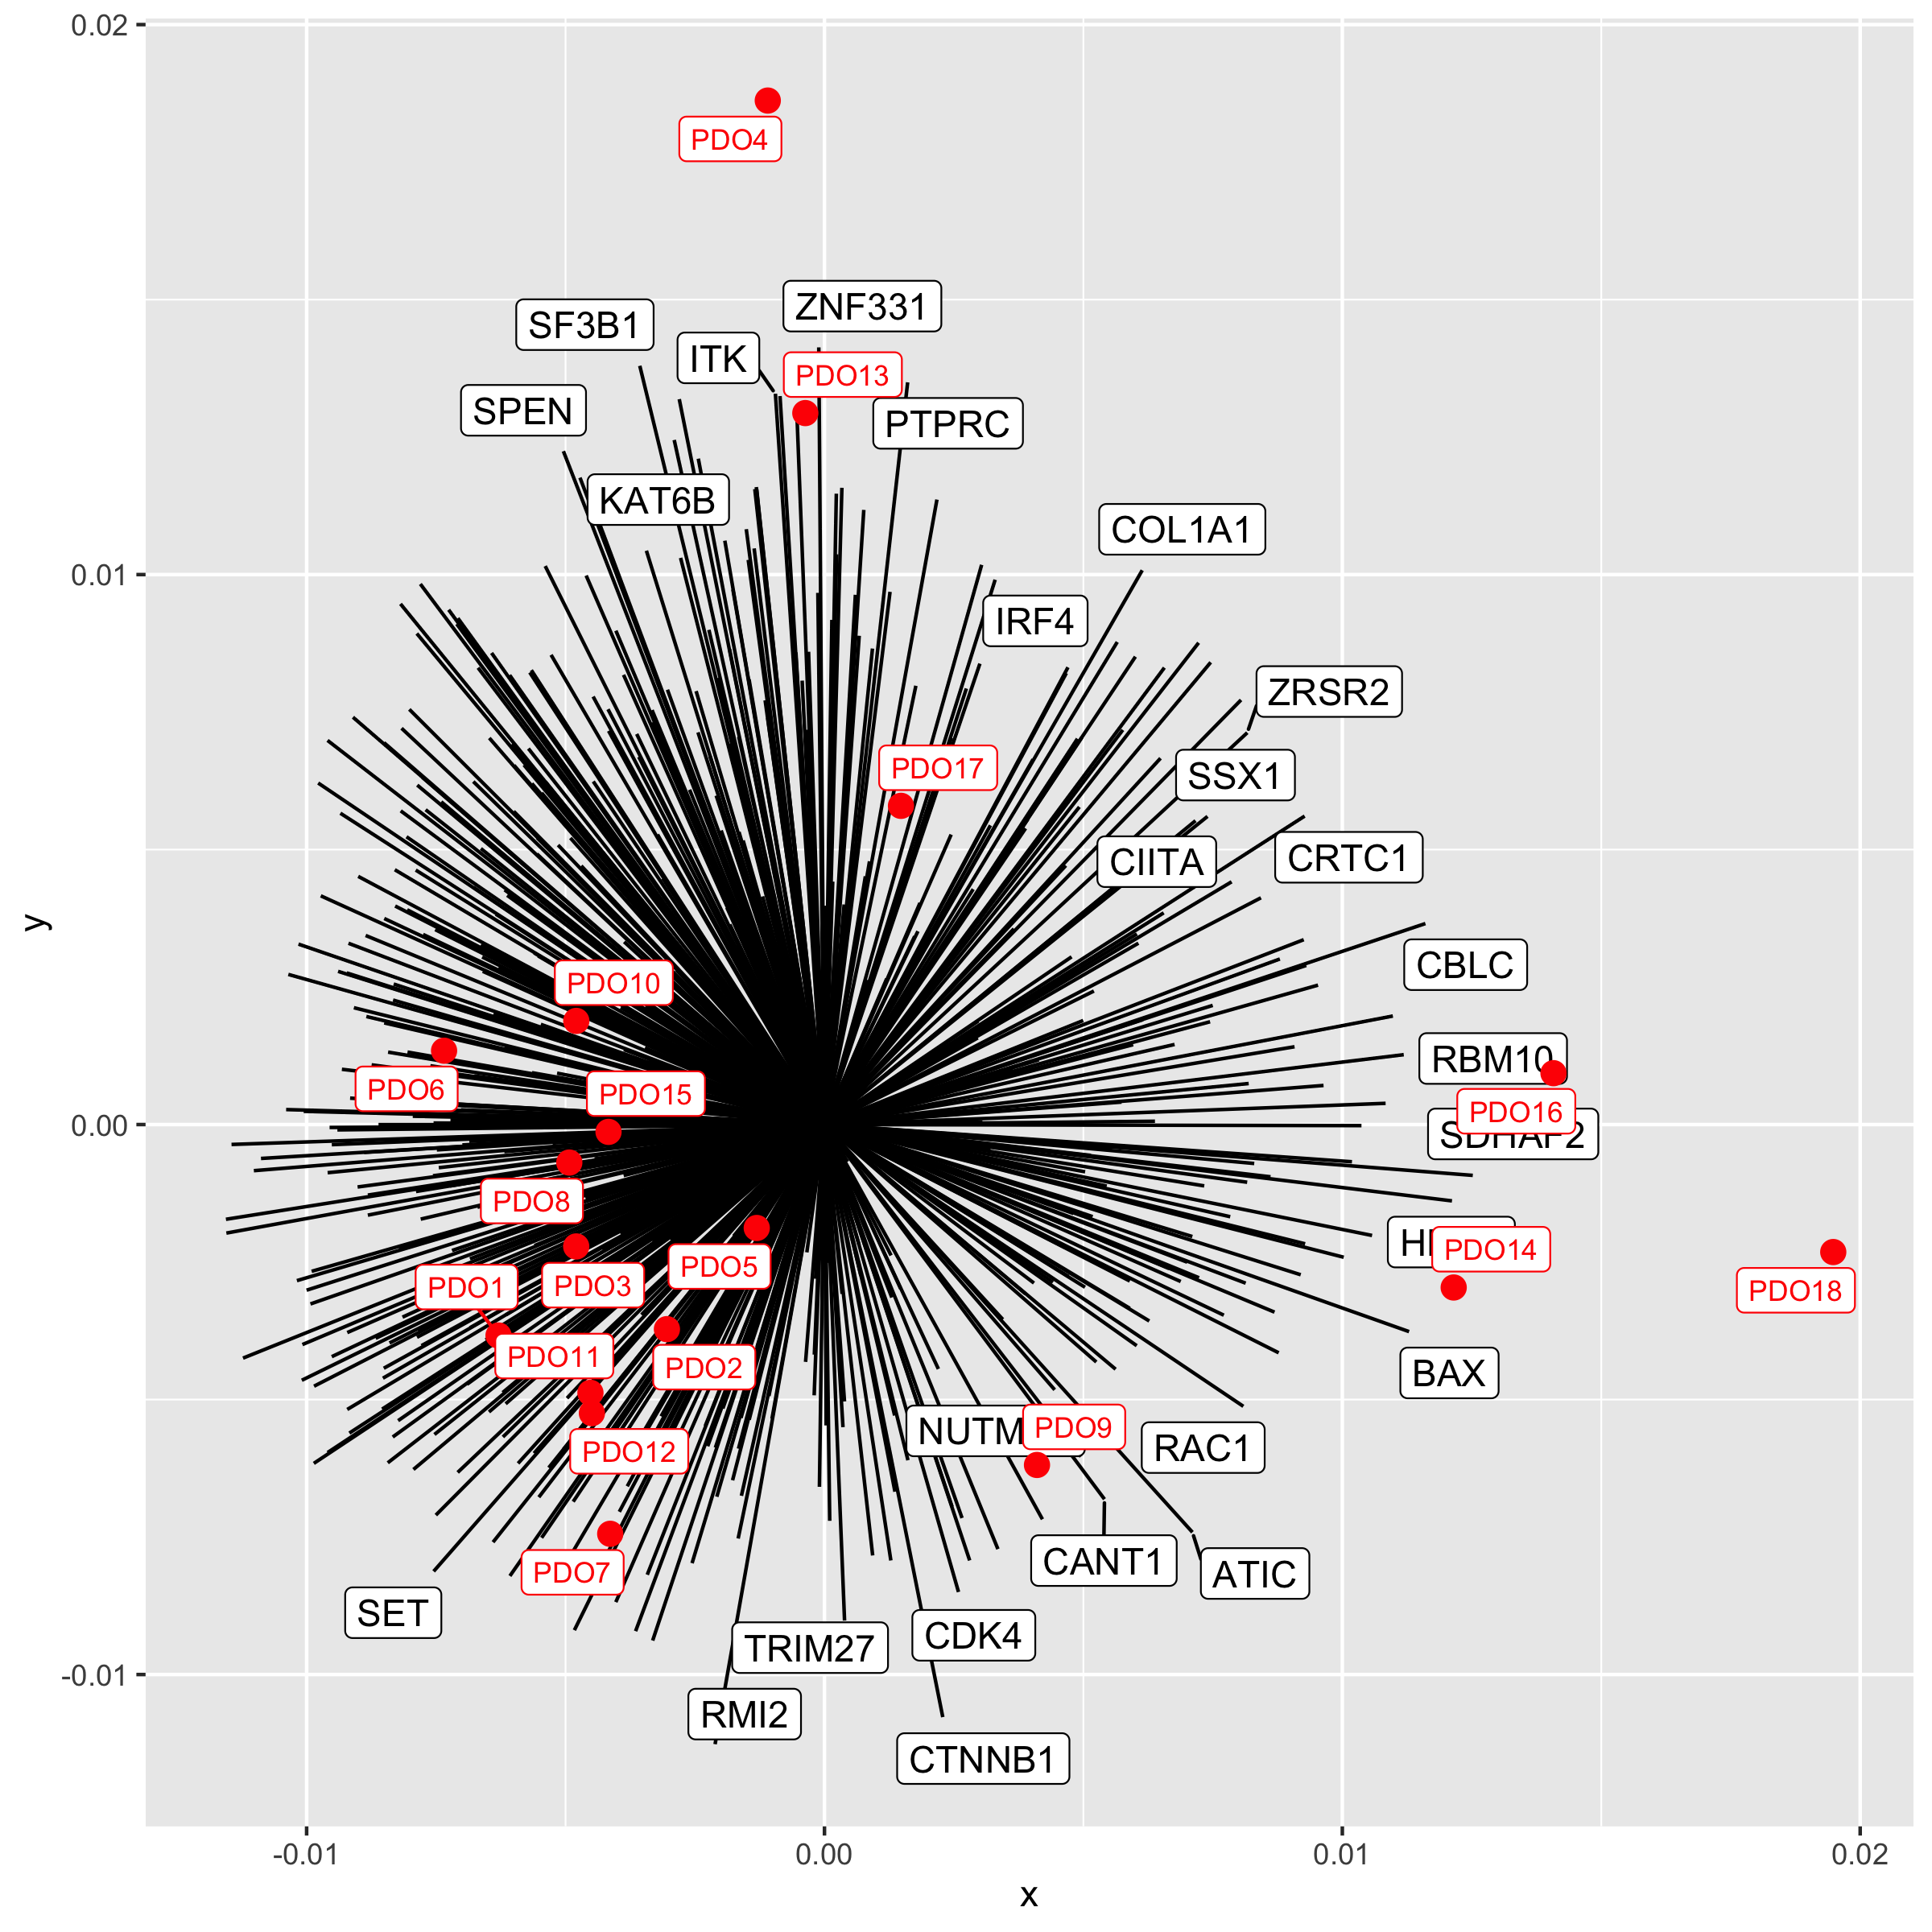
Loadings of CGC Tier 1 gene, and organoids
Only including organoids
Normalised counts

Slide 6
Clustering on cosine similarity, with k=10, and annotation of the genes that belong to each category
Only including organoids
Normalised counts

Slide 7
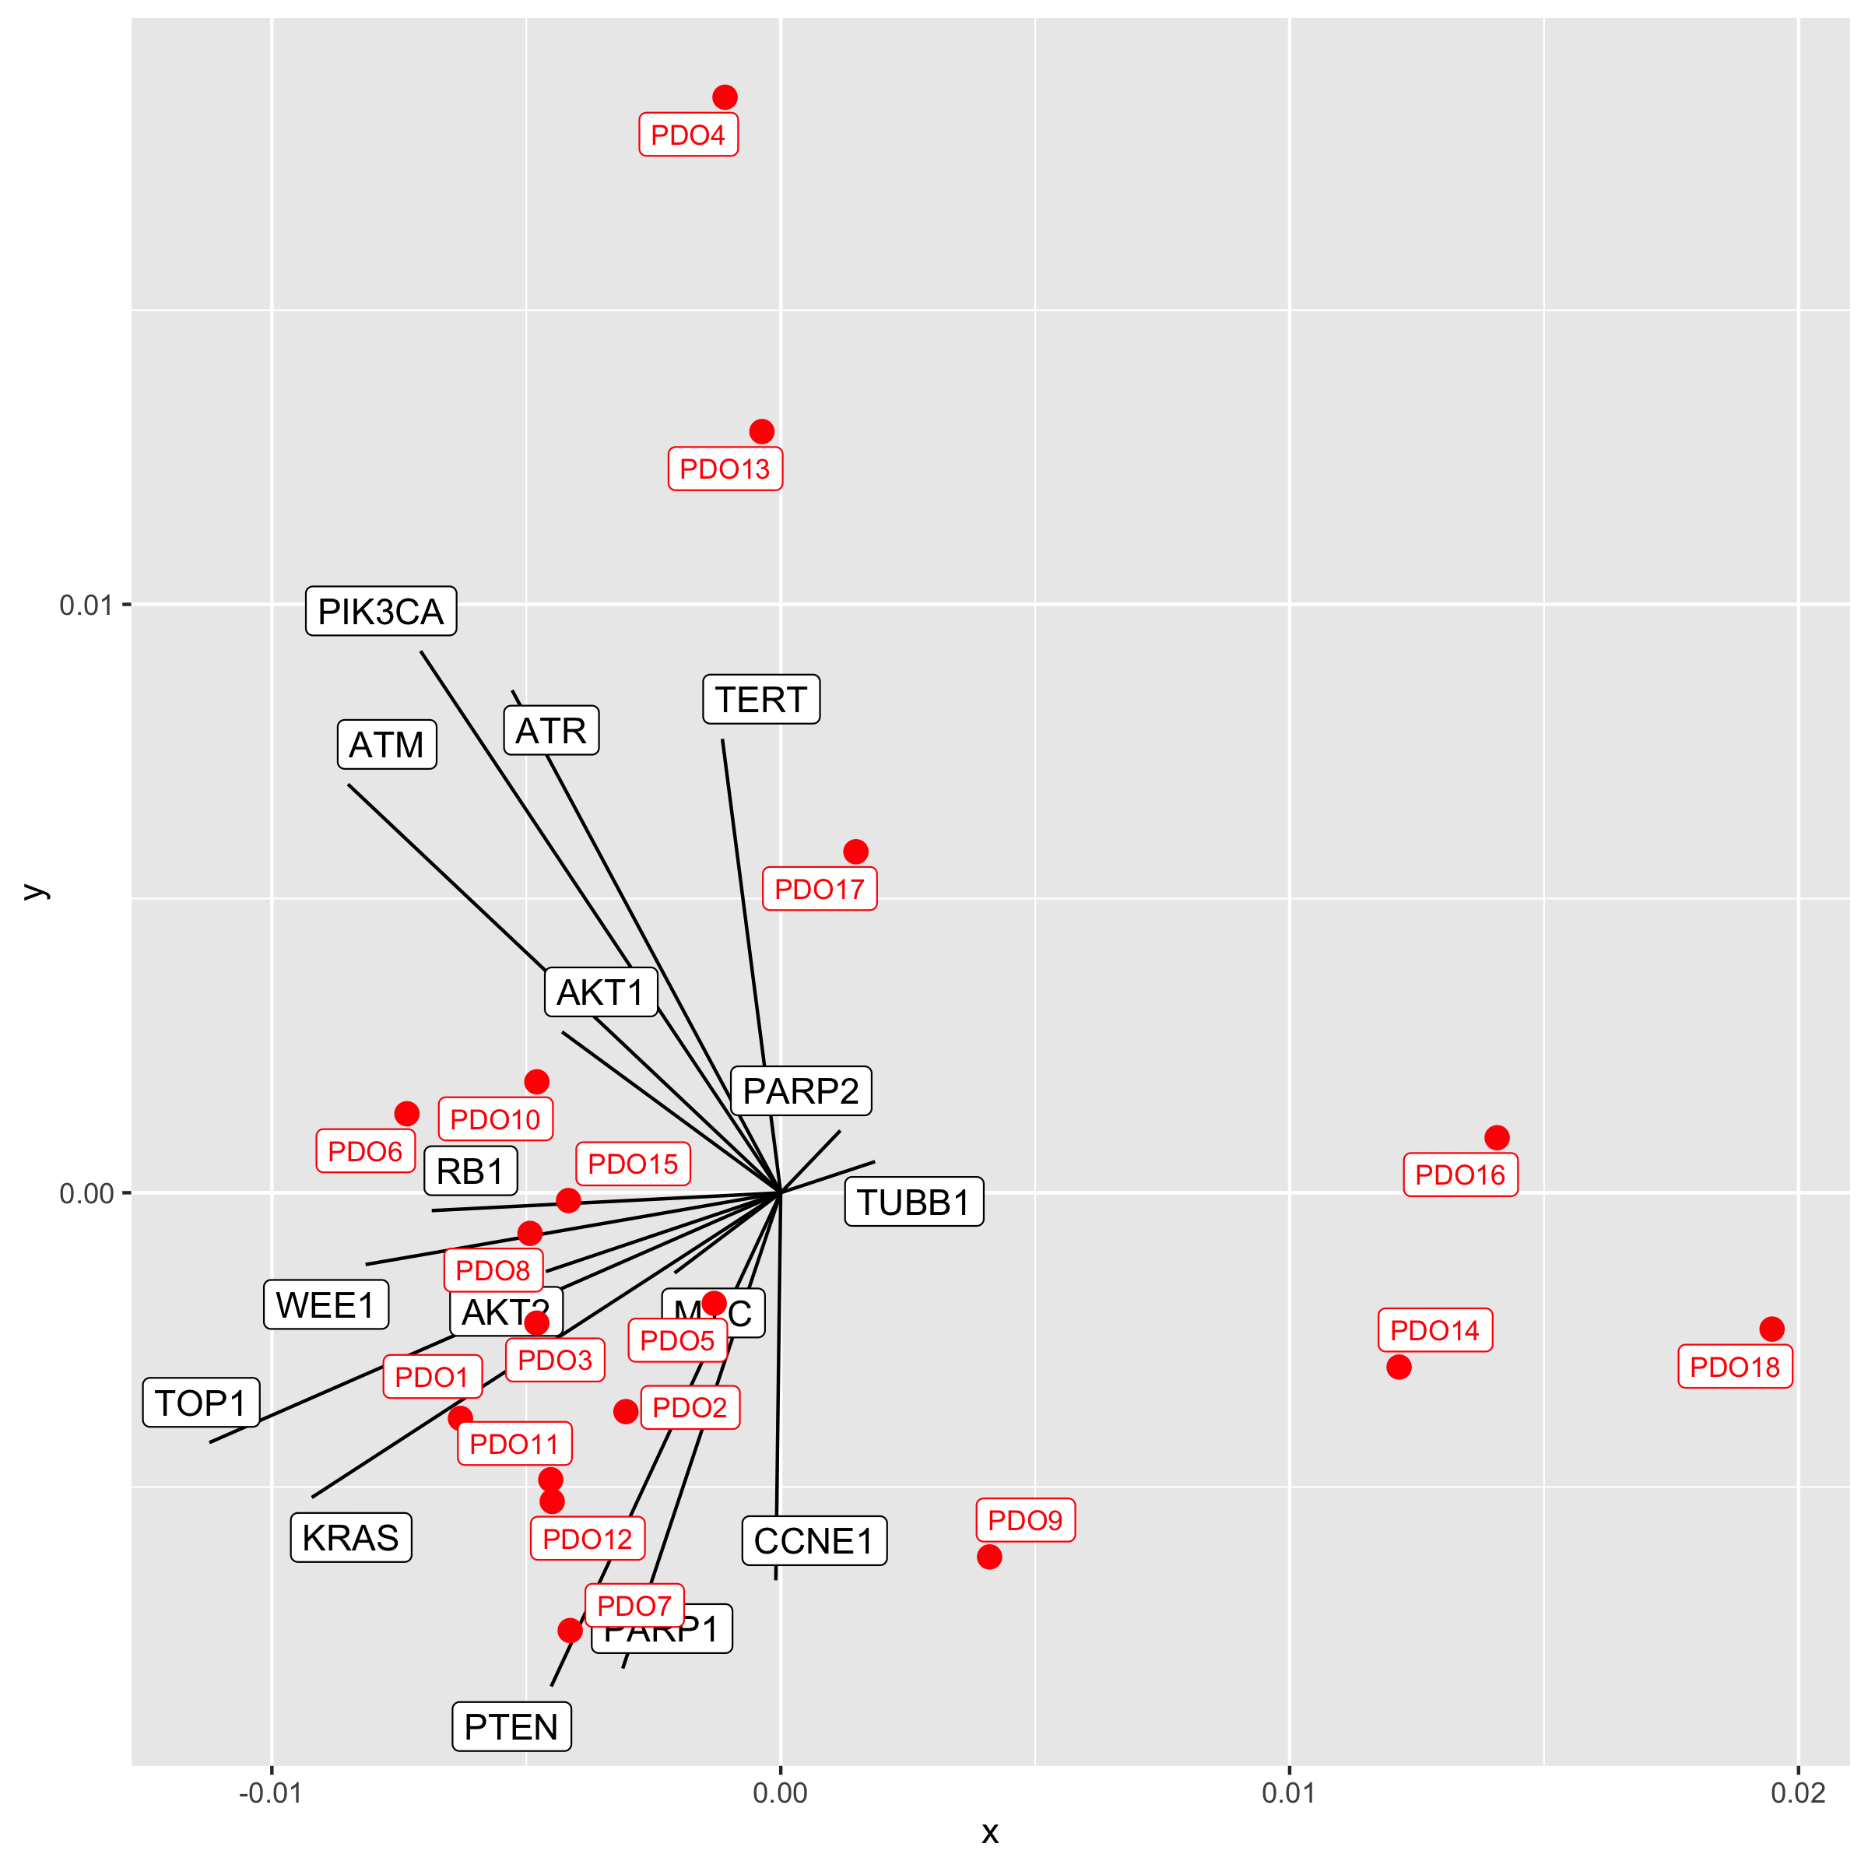
Genes of interest
Only including organoids
Normalised counts

